Slide 1


Mobility as a Service - Sustainable Nordic cities focusing on climate-smart mobility
Persontrafik 2018

Slide 2

Swedish roadmap for MaaS
Per-Erik Holmberg, RISE (per-erik.holmberg@ri.se)
Anna Pernestål, KTH/ITRL (pernestal@kth.se)

Slide 3

” Mobility-as-a-Service (MaaS), describes a shift away from personally owned modes of transportation and towards mobility solutions that are consumed as a service. This is enabled by combining transportation services from public and private transportation providers …”
Wikipedia
” "... att en resenär kan lösa sitt resbehov från dörr till dörr genom en sammanhållen tjänst. Resan kan omfatta olika trafikslag som tillhandahålls av olika aktörer, men resenären erbjuds en sammanhållen tjänst och betalar för den sammanhållna tjänsten enligt ett i förväg upprättat avtal (som kan vara i form av ett abonnemang).”
ITS Handlingsplan 2016
"... carsharing, taxis and shared taxis, bicycle and bike-sharing, car-pooling, demand-responsive transport, car-rental, etc., are services that can complement the classic fixed line- and timetable-bound public transport services and, together with walking, they form a complete and coherent mobility solution.
UITP
"... mobility distribution model in which a customer’s major transportation needs are met over one interface and are offered by a service provider ... //... The central element of Mobility-as-a-Service requires a mobility platform that offers mobility services across modes.“
MaaS Global

Slide 4
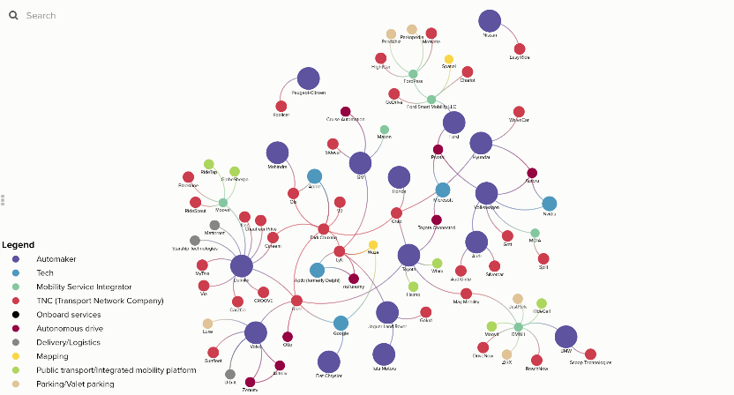
Drive Sweden, M.Collado

Slide 5

COMBINED MOBILITY AS A SERVICE UP-SCALING IN SWEDEN

Slide 6


Slide 7
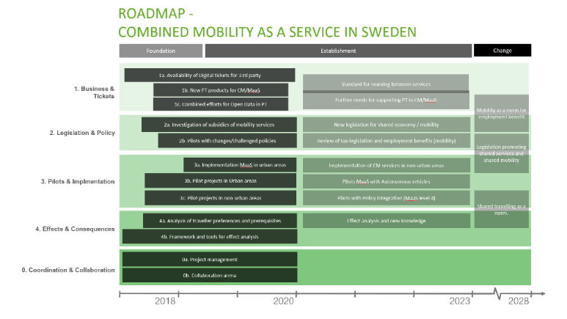

Slide 8

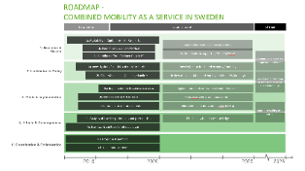









COMBINED MOBILITY AS A SERVICE UP-SCALING IN SWEDEN
Energimyndigheten
Challenge from Sweden
Sustainable Mobility as a Service
Stimulates demand in new domain/areas from a user perspective
Drive Sweden
KOMPIS
Stimulates serviceproviders and entrepreneurs in developing MaaS services
Samtrafiken/Public Transport
Bob & Öppen data & Digitalisering av biljetter
Co-ordinated in a national Roadmap
Enabling public transport to be an important component in the MaaS ecosystem
Trafikverket
Nat. Actionplan ITS/MaaS
Enabling infrastructure and ITS-services for the MaaS landscape

