Slide 1
Enabling MaaS through legislation
The Act on Transport Services in Finland
24.10.2018
Saara Reinimäki @saarare

Slide 2
A Finn travels 41 km daily, mostly by car
…and alone.
Source: Henkilöliikennetutkimus 2016, Finnish Transport Agency

Slide 3
Mobility as a Service
MaaS provides freedom of choice and ease for transport users.
Transport services are built around customers’ needs while attaining transport policy objectives.
MaaS presents national and global business opportunities.

Slide 4
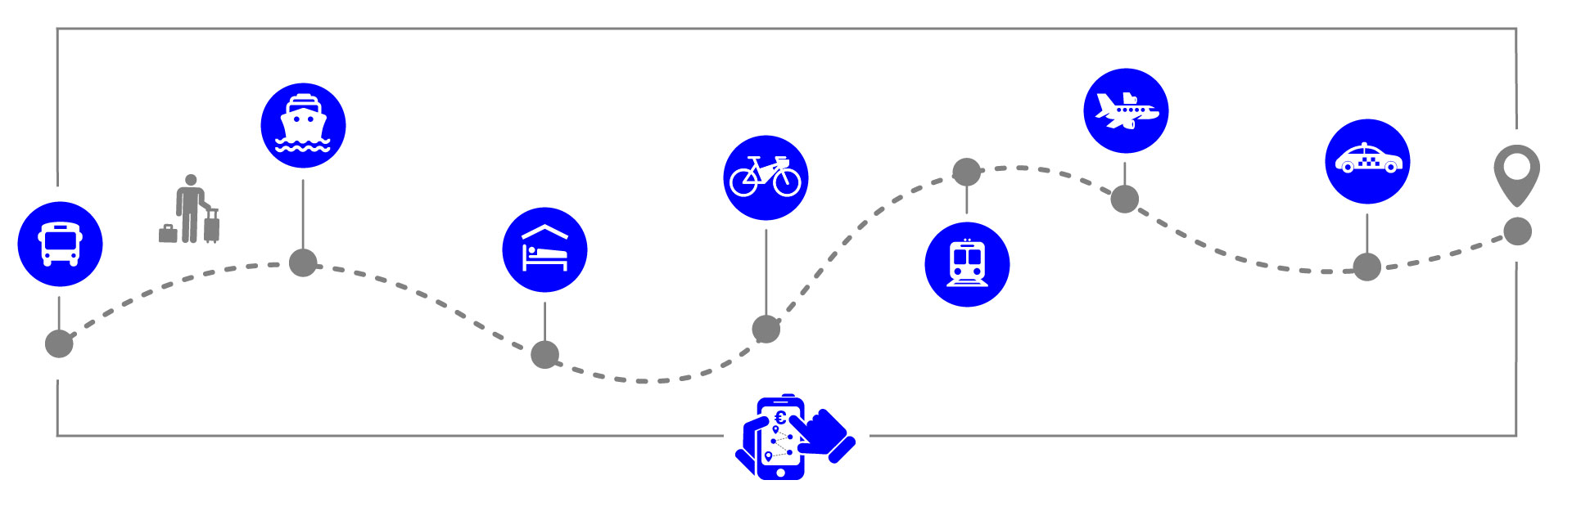
Basic principles on enabling MaaS and travel chains
Customer centricity
Easier market access & use of data – more room for innovation
Unfragmented transport legislation, streamlining across modes and services
Technology neutral rules
Sustainability

Slide 5
Act on Transport Services
Better and more agile services
SERVICES
MaaS operators, apps, platforms, etc.
Data utilisation and regulation
DATA
Enabling digital services: APIs, open data
Deregulation and market access

Slide 6
With the help of data – interoperable mobility ecosystem
Where we want to be
From closed, local ticket systems to interoperable, online payment systems
From local to international mobility services and travel chains
How we encourage
Public procurement only if interoperable ticket and payment systems
Help and flexibility particularly for small operators (i.e. technical assistance in opening data)
Open data interfaces

Slide 7
Enabling easy travel chains in the Act on Transport Services
Essential data on mobility services (APIs) | Anonymous single tickets (interoperability of ticket and payment systems)
All transport modes and services | Road and rail transport services
Phase I
1/2018
Data concerning the use of transport services | Personal tickets (with an account in a digital service)
Open interface of the Finnish Transport Agency (anonymous and non-anonymous) Open data | Seasonal tickets Student and senior discounts etc. All transport modes All transport services
Phase II 7/2018
1/2019

Slide 8
Are we there yet?
The demand for taxi permissions has risen.
Finnish MaaS-operators are creating new services with the assistance of new legislation – data sharing is the key.
Finland continues to encourage trials and pilots.

Slide 9
Act on Transport Services & MaaS: takeaways
Interoperability of different parts of the transport system
Better use of data resources
Easier market access
Business opportunities
Technology neutrality
Lighter regulation
Savings
Decarbonisation & sustainability

Slide 10
Thank you!
lvm.fi Twitter: @saarare Instagram: @lvmfi

